Slide 1
Tax & Revenue Basics
A primer for legislators

Slide 2
Oregon’s tax policy law
“The goals of the Legislative Assembly are to achieve for the people of this state a tax system that recognizes fairness and equity as its basic values”
Oregon Revised Statute 316.003

Slide 3
Guiding principles to evaluate tax proposals
Ability to pay
Fairness
Efficiency
Even distribution
The tax system should be equitable where the minimum aspects of a fair system are:
That it shields genuine subsistence income from taxation
That it is not regressive and
It imposes approximately the same tax burden on all households earning the same income
Adequacy and
Flexibility
ORS 316.003

Slide 4
Tax Fairness Oregon’s work
Identify, research, and analyze critical bills
Recommend changes to Oregon’s tax code
Build coalitions with partner organizations
Bring public attention to tax issues
Meet with legislators and testify at hearings

Slide 5
Oregon ranks 10th among states for fairness*
Progressive features
Regressive Features
Progressive income tax
No sales tax
Refundable State Earned Income Tax Credit
Childcare tax credit
State estate tax
Income tax structure is essentially flat
Employees pay higher tax rates than business owners
Many tax loopholes
*Institute on Taxation & Economic Policy (ITEP), ”Who Pays” (10/2018)
Notes:
Income tax 8.75% tax rate at taxable income of $18,900 for joint filers/half that for individuals Loopholes: Mortgage Interest deduction,
9.9% rate begins at $250,000 for joint filers Unlimited deduction of social security income
Unlimited deductions favor wealthier taxpayers Unlimited deductions except some deductions are phased out
Deduction of up to $7050 in federal tax with phase out at $250,000 gone at $290,000/joint – the top 4%

Slide 6
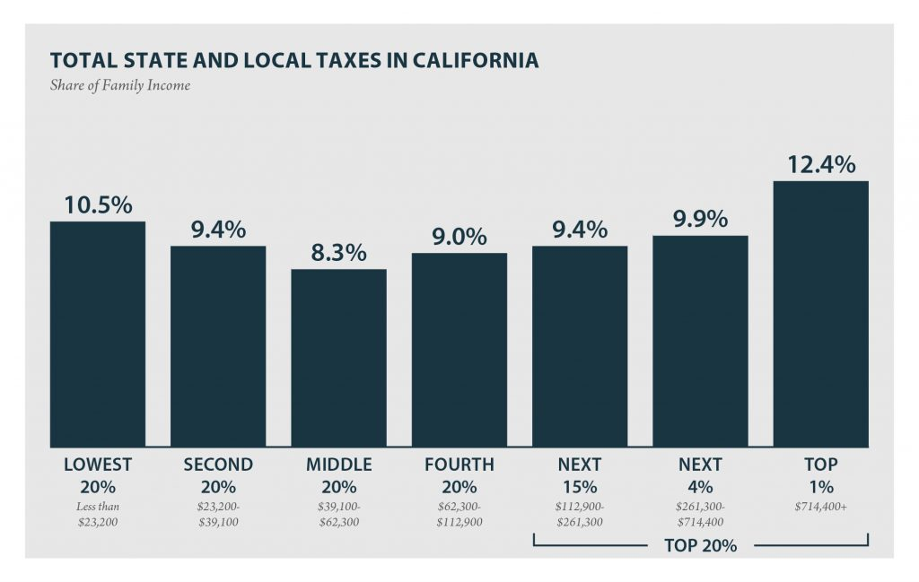
Oregon: between ends of fairness
Washington - most regressive
No income tax
High sales tax
California - most progressive
Higher tax rates on high incomes
Much lower rates on low incomes
ITEP

Slide 7
Tax equity in Oregon
ITEP
Lowest quintile pay greater share of income in taxes than any other
Top 1% pay lowest share

Slide 8
Changes since the 2009 recession
Progressive
Added 9.9% rate to PIT
Added 7.6% rate to CIT
Raised Corporate Minimum Tax
Made EITC and Childcare credits refundable
Added Corporate Activity Tax (CAT)
Regressive
Lowered pass-through rate
PIT rate cut in CAT tax
Opportunity Zones
SALT tax workaround
Notes:
Since 2009 when the PIT and CIT rates were increased, Pass through tax rate reduction passed in 2013, Opportunity Zones created by Congress in 2017 and CAT added in 2019 while cutting three lowest PIT rates by .25%,

Slide 9
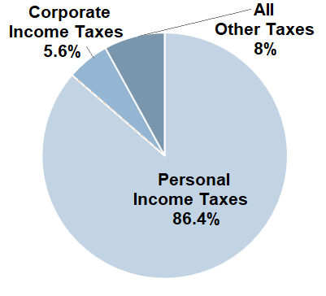
General Fund relies on personal income tax
Corporate Income Tax has shrunk from 16% share in the 1980’s
Source Data: LFO 2019-2021 Budget Highlights

Slide 10
Other taxes in the General Fund
Tobacco – referral on 2020 ballot passed adding $2/pack
Alcohol – beer and wine taxes are some of the lowest in US
Marijuana – 17% of sales in Oregon, vs 37% in Washington State and 34% or so in California. In each state local sales taxes are part of the tax
Estate tax – 21 states have an estate or inheritance tax

Slide 11
Oregon Total Funds Budget: $112.8 billion
Up from $86B, or 31% above prior biennium beginning budget
Other Funds:
Highway fund from gas tax, auto registration
Fees for services
Unemployment Insurance
Fish and Wildlife
Transient lodging tax
Student Success (CAT)
Notes:
Budget. For 21-23: The General Fund is up $3.2B, Lottery Funds are up $0.1B, Other Funds are up $10.7B and Federal Funds $13.2B. The new graph will look a lot different.

Slide 12
How the legislature spends money
Budget Spending – regular authorizations from committees, “Christmas Tree bill,” emergency board allocations
Tax expenditures – compete with revenue requirements
Bonds – limit of 5% General Fund debt service to General Fund revenue

Slide 13
Student Success Act/Corporate Activity Tax (CAT)
Effective 1/1/2020 (enacted 2019)
0.57% rate on all Oregon sales above $1 million, less 35% of wages or cost of goods attributed to Oregon sales
All revenue dedicated to pre-school and K-12 education
Lower Personal Income Tax (PIT) rates for three lowest tax brackets Example: 5% to 4.75%
Some businesses are passing it along and using it as a profit point

Slide 14
Revenue issues 2023
Gain Share
Enterprise zones and the SIP
Opportunity Zone disconnect
Auction of tax credits
Additional tax expenditure sunsets
Mortgage interest deduction
Notes:
CAT issues: additional exemptions, tax show on receipts as a profit center
Additional sunsets – 51 sunsets in 2009, now many fewer, sunsets work!

Slide 15
Structural Issues
Prohibiting counties from exempting property from K-12 taxes
Ending slush fund for Travel Oregon from lodging taxes
Reforming the kicker
Fixing our broken property tax system

Slide 16
Perennial fights
New tax credits
Beer and Wine taxes – lowest and near bottom in the country
Cannabis – lower than neighbors’ WA 37%, CA 28-40%, OR 17-20%
Estate tax
Notes:
Examples: $1000 tax credit for being a volunteer firefighter, tax credit for adopting a dog from a shelter

Slide 17
Resources
Where our revenue comes from:
Oregon Public Finance: Basic Facts - each year
Where our revenue doesn’t come from:
Tax Expenditure Report - each biennium

Slide 18
Thank you!
We are pleased to answer questions and research ideas
We will seek your support during session
Lobbyists will pressure you to support special interest tax breaks
We will remind you of Oregon’s commitment to tax fairness and the need for revenue to support your district and the state
TaxFairnessOregon@gmail.com
Jody Wiser (503) 810-6654
TaxFairnessOregon.org

Slide 19
Tax Fairness Oregon’s goals
Consistent and adequate revenue
Revenue stability that supports long term and strategic budgeting for high-quality and efficient public services
Horizontal and vertical fairness
Similarly situated households and businesses should pay the same tax on the same income and/or assets
Efficient tax expenditures
Tax credits used only when direct appropriations are less efficient
Disallow sale for tax purposes

